Slide 1
BIE ELA & Math Spring 2025 Assessment Pre-Administration Training
January 7, 2025 (in-person)
January 16-17 & 23-24, 2025 (virtual)
1

Slide 2
Welcome & Purpose
2

Slide 3
Welcome & Purpose
Welcome from the Chief Academic Office and the ELA/Math Assessment Team.
Aurelia Shorty, Dr. Carmelia Becenti, & Dr. BJ Howerton
The purpose of these trainings is to:
Provide implementation assistance to schools for BIE’s Summative ELA and Math Assessments for SY 2024-2025.
Provide a set of expectations for assessment tasks and activities before, during, and after testing.
To assist school staff with scheduling, the trainings will be recorded for your viewing convenience.

Slide 4
Housekeeping
Training PowerPoint is posted to https://bie.mypearsonsupport.com/
Virtual trainings will be recorded.
For in-person training, time will be allotted for any questions.
For virtual trainings:
Please be sure to mute your microphone, if applicable.
Questions may be posted in the Q&A.

Slide 5
Agenda
Key Administration Dates
Test Structure & Guidelines
Accommodations & Accessibility Features
Before Testing Tasks
During Testing Tasks
After Testing Tasks
Resources

Slide 6
Key Administration Dates
6

Slide 7
Key Administration Dates – Pre-Admin
JANUARY 31
MARCH 3
Deadline to update & verify Student accommodations in ADAM
Initial shipment of test materials scheduled to arrive in schools

Slide 8
Key Administration Dates – Admin
MARCH 4 - APRIL 24
MARCH 17 -APRIL 25
Additional Orders Window
TEST ADMINISTRATION WINDOW

Slide 9
Key Administration Dates – Post-Admin
APRIL 25
MAY 2
MAY 5
MAY 9
Deadline to return scorable Paper testing materials to Pearson
Deadline to return non-scorable materials to Pearson
Deadline to resolve Paper rejected test alerts in ADAM
Deadline to manually submit all tests in ADAM

Slide 10
Test Structure & Guidelines
10

Slide 11
BIE Guidelines
Paper-based tests (PBT) versus Computer-based tests (CBT):
The BIE will not order PBT for schools that have been identified to use the CBT. The BIE encourages schools use CBT if they have the technical capability to do so.
Exception would be for students needing paper as an accommodation for IEP or 504. Contact the BIE if you have further questions.
Participation – All students in grades 3-8 and 11 will take the Spring ELA and Math Assessment per ESSA.
No Remote Testing – If students are learning remotely and a school is not able to test students securely, contact BIE for guidance. Paper-based tests cannot be sent home.

Slide 12
Test Structure & Guidelines
Computer-Based and Paper-Based Testing
March 17 – April 25, 2025
Test Administration
Window
English Language Arts
Grades 3-8
Grade 11
Mathematics
Grades 3-8
Algebra I
Algebra II
Geometry
Integrated Math I, II, & III
Tests
Administered

Slide 13
Test Structure & Guidelines
On-Grade Level Testing Only
3-8 Math/ELA students are only allowed to take the test for their grade level (i.e., 3rd graders can take Grade 3 Math and Grade 3 ELA).
Grade 11 students can take Algebra I, Geometry, Algebra II or Integrated Math I, II, III. They should take the test that aligns with the course they are currently enrolled in.
If a student is enrolled and takes more than 1 HS Math test, the more advanced test will be reported (i.e., if a HS student takes Algebra I & Algebra II, only Algebra II will be reported).
Exception: Grade 8 students can take Algebra I if they are currently enrolled in Algebra I.

Slide 14
Test Structure & Guidelines – ELA Testing Times
Grade(s)​ | Content Area/Course​ | Number of Units​ | Time​ | Total Time​
3​ | ELA/Literacy​ | 3​ | Units 1-2: 75 minutes Unit 3: 35 minutes​ | 185 minutes​
4-8​ | ELA/Literacy​ | 3​ | Units 1-2: 90 minutes Unit 3: 40 minutes​​ | 220 minutes​
11 | ELA/Literacy​ | 3​ | Units 1-2: 90 minutes Unit 3: 40 minutes​​​ | 220 minutes​

Slide 15
Test Structure & Guidelines – Math Testing Times
Grade(s)​ | Content Area/ Course​ | Number of Units​ | Calculator | Time​ | Total Time​
3​-5 | Mathematics | 3​ | No Calculator | 60 minutes​ | 180 minutes​
6 | Mathematics | 3 | Unit 1- Non-calc & Calc section Unit 2 & 3 - Calc | 60 minutes​ | 180 minutes​
7 | Mathematics | 3 | Unit 1- Non-calc & Calc section Unit 2 & 3 - Calc | 60 minutes​ | 180 minutes​
8 | Mathematics | 3 | Unit 1- No Calc Unit 2 & 3 - Calc | 60 minutes​ | 180 minutes​

Slide 16
Test Structure & Guidelines – Math Testing Times
Grade​ | Content Area/ Course​ | Number of Units​ | Calculator | Time​ | Total Time​
HS | Algebra I​ | 2​ | Unit 1- Non-calc & calc section Unit 2- Calc | 90 minutes​ | 180 minutes​
HS | Geometry | 2​ | Unit 1- Non-calc & calc section Unit 2- Calc | 90 minutes​ | 180 minutes​
HS | Algebra II | 2 | Unit 1- Non-calc & calc section Unit 2- Calc | 90 minutes | 180 minutes
HS | Integrated Math I, II, III | 3 | Unit 1- Non-calc & calc section Unit 2 & 3- Calc | 60 minutes | 180 minutes
Notes:
Calculator

Slide 17
Test Structure & Guidelines – Scheduling Considerations
Computer-based Testing
For security purposes, each unit (e.g., Unit 1, Unit 2, Unit 3) should be scheduled as ​close together as possible for all students within the same grade/course – with​ the exception of make-up testing.
Test units must be administered in consecutive order.
Schedule the first CBT group on the first day with a little more time than other groups if possible.

Slide 18
Test Structure & Guidelines – Scheduling Considerations
Paper-based Testing
For security purposes, each unit MUST be completed by all students for the same grade/course on the same school day – except for make-up testing or students with an extended time accommodation. ​
For example, all students enrolled in Algebra I should complete Algebra I, Unit 1 on the same day. This may require scheduling more than one testing block for each unit on a given day.
Test units must be administered in consecutive order.
Schools must have the grade level appropriate calculator (grades 6-8, HS) if administering math on Paper.

Slide 19
Test Structure & Guidelines – Scheduling Considerations
Determine whether one content area will be completed before beginning the next, or if testing will alternate between the content areas (excluding make-up testing).
Determine whether the school wants to condense testing (excluding make-up testing) or spread throughout the testing window.
Determine how many units will be taken by students per day (excluding make-up testing).
If the unit testing times and directions are the same, different tests can be administered in the same room.
i.e., Algebra I and Geometry can be administered in the same room.
ELA/Math cannot be administered in the same room because the directions are different.
Ensure that all calculator/non-calculator sections are the same (e.g., Grade 6 & 7).
CBT and PBT CANNOT be administered in the same environment.
Do not start a unit unless there is sufficient time left in the day to complete the unit.
Testing times are Monday – Friday during regular school hours.

Slide 20
Test Structure & Guidelines – Guidelines for Administration Time
Guidelines For Scheduling​ | Task​ | Administration Time​
 | Pre-administration tasks, including reading instructions to students and answering questions​ | 10 minutes​ (recommended)​
 | Distribution of test materials to students​ | 5 minutes​ (recommended)​
 | Administration of unit​ | Refer to Unit Testing Times (60-90 minutes)​*
 | End-of-unit activities, including logging students out of TestNav and collecting test materials​ | 5 - 15 minutes​ (recommended)​
*Testing time depends on unit and subject-refer to Testing Multiple Grades in the TCM

Slide 21
Test Structure & Guidelines – Guidelines for Administration Time
Guidelines for Administration Time
Schedule the entire amount of Unit Testing Time.
Once the Unit Testing Time has elapsed, that unit must end.
If all students have completed the unit, the unit may be ended early (no minimum testing time).
Plan a couple of extra days during the window for bad weather days and makeup testing.

Slide 22
Test Structure & Guidelines – Guidelines for Breaks
Between units, scheduled breaks may occur.
During a unit, short “stand-and-stretch” breaks may be permitted at the discretion of the Test Administrator.
Time stops for the unit, but only for a maximum of 3 minutes.
If you know you will take the 3-minute break, this should be added to the timing box at the beginning of the unit.
8:00 a.m. – 10:00 a.m. | Unit 1
10:00 a.m. – 10:15 a.m. | Scheduled Break
10:15 a.m. – 12:15 p.m. | Unit 2

Slide 23
Test Structure & Guidelines – ELA Writing Prompt
Every ELA test will have a writing prompt in Unit 2. This will require the student to read and respond to the prompt by writing an essay.
Example scoring rubrics can be found at https://resources.newmeridiancorp.org/ela-test-design/.
Released student essays and annotated scores can be found and reviewed at https://resources.newmeridiancorp.org/released-items/.
Non-secure ELA practice tests for all grades are available at https://bie.mypearsonsupport.com/practice-tests/english/.
ELA Interim 2 tests all include a writing prompt, which allows both for students to familiarize themselves with a similar prompt and associated tools in TestNav and provides reports for school staff.
All BIE schools are eligible to take Interim assessments.

Slide 24
Accommodations & Accessibility Features
24

Slide 25
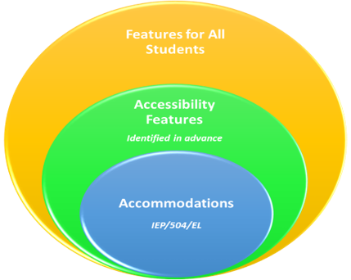
Accommodations & Accessibility Features
Features for All Students
TestNav tools available to all students
Administration Considerations
Testing environment
Accessibility Features
Answer mask / color contrast
Accommodations
Requires IEP/504 or EL plan
Test Coordinators will need to confirm that the correct accommodations have been added to the students’ record by viewing the student details in ADAM and update as needed.

Slide 26
Accommodations & Accessibility Features
CBT Accessibility Feature examples (TestNav)
These are available or should be made available to all students:
Line Reader
Answer Eliminator
Magnifier
Highlighter
Bookmark
Pop-up glossary
Notepad
Blank Scratch Paper*
*After testing Test Administrators are responsible for collecting ALL scratch paper after testing has completed to be securely destroyed.

Slide 27
Accommodations & Accessibility Features
Administration Considerations examples
These should be identified in advance of testing:
Adaptive and Specialized Equipment or Furniture​
Frequent Breaks​
Small Group Testing​
Specified Area or Setting​
Separate or Alternate Location​
Time of Day​
NOTE: These do NOT need to be captured on the student record in ADAM.

Slide 28
Accommodations
Accommodation form specific examples**
Computer Based:
American Sign Language
​Assistive Technology (Screen Reader or Non Screen Reader)
Closed Caption
Read Aloud / Human Reader
Text to Speech
Paper Based:​
Braille​
Large Print
Paper
*Students cannot have multiple form specific accommodations.
*Accommodations MUST be updated on the student record in ADAM and require an IEP/504 or EL plan.

Slide 29
Accommodations
Differences between Text-to-Speech, Screen Reader, & Human Reader/Read Aloud
Text to Speech – Computer reads the content via the TTS functionality. This is not for blind or low-vision students.
For Math:
Text with graphics - reads all printed text and the hidden alternate text descriptions for images.
Text only - reads printed text but does not read any alternate text descriptions for images.
Screen Reader – For visually-impaired students using a program that reads the screen and read Braille (e.g., JAWS).
Human Reader / Read Aloud – Assessment is read aloud by test administrator (student can test either CBT or PBT).
Math requires an approved accommodation, and the provided script must be used.
ELA requires an approved accommodation, but no script is provided due to testing the student’s reading ability.

Slide 30
Before Testing Tasks
30

Slide 31
LaunchPad & ADAM
31

Slide 32
NASIS
NASIS Administrator
Demographic Information
Name
Gender
Date of Birth
Ethnicity
Grade
NASIS ID*
English Learner Participation
SPED Staff
SPED Bureau of Indian Education Reporting
Special Ed Status
Primary Disability
Special Ed Setting
IEP Review
Test Accommodations
Alternate Assessment

Slide 33
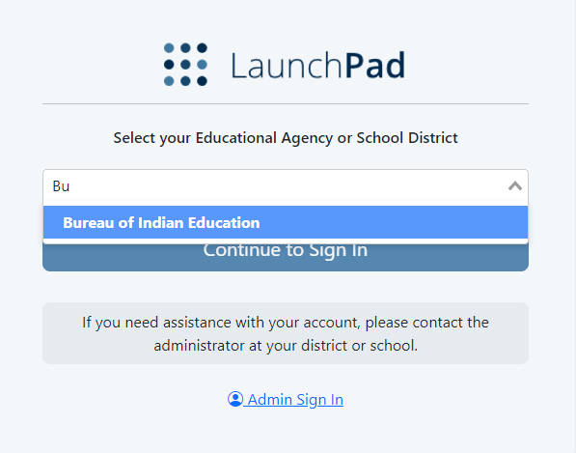
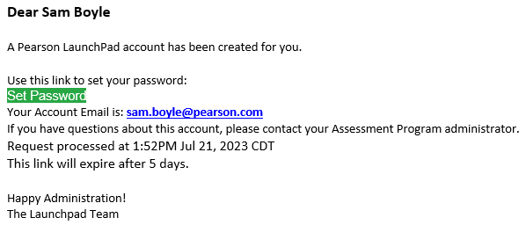
LaunchPad
LaunchPad is the single sign on (SSO) for all Pearson testing products used by the BIE. A welcome email from LaunchPad System will be sent to IT staff, School Administrators, & Test Coordinators with a link to set a password.

Slide 34
LaunchPad – New Users
Once new users are added to LaunchPad they will be sent a welcome email with a link to set their password.
When a new user selects the link, they will be asked to update to a password of their choosing. Links expire after 5 days.
After successfully logging into LaunchPad, users should be able to select ADAM from the available application tiles.
If you do not have LaunchPad access, first ensure your school’s API integration with NASIS is in place.

Slide 35
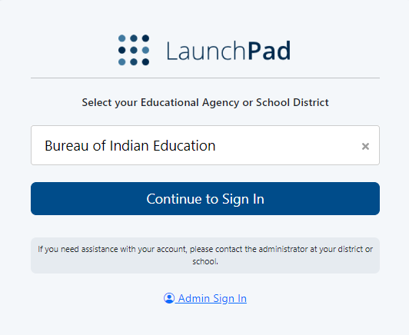
LaunchPad Login
Once a password has been set, to login to LaunchPad navigate to https://launchpad.pearson.com/#, select Bureau of Indian Education from the Educational Agency or School District list, then select Continue to Sign In.

Slide 36
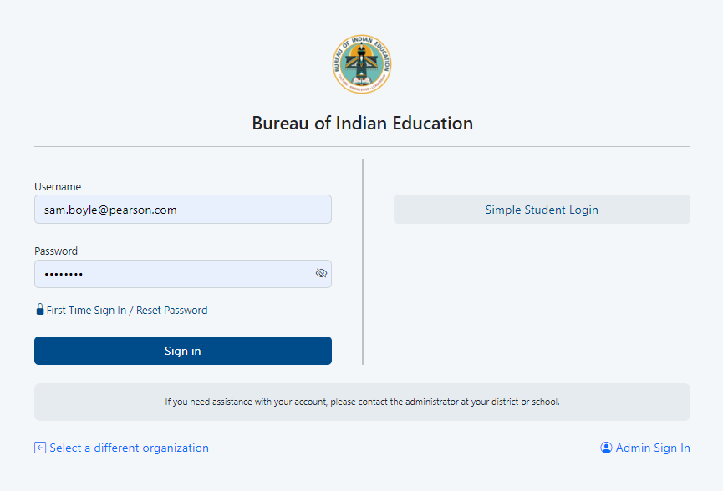
LaunchPad Login
On the Bureau of Indian Education sign in screen, enter your username & password and select Sign In.

Slide 37
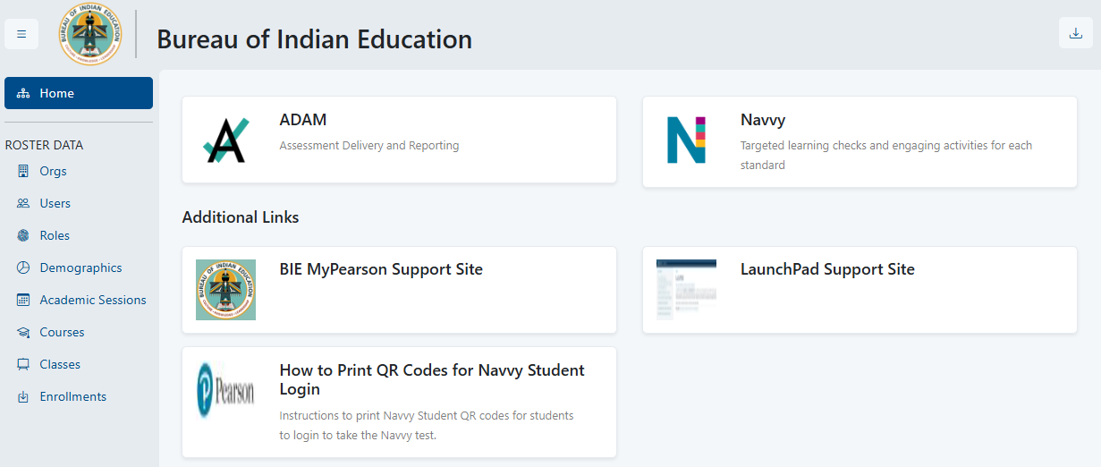
LaunchPad
Once logged in to LaunchPad, select the ADAM tile from the available apps. Once selected you will automatically be logged into ADAM.

Slide 38
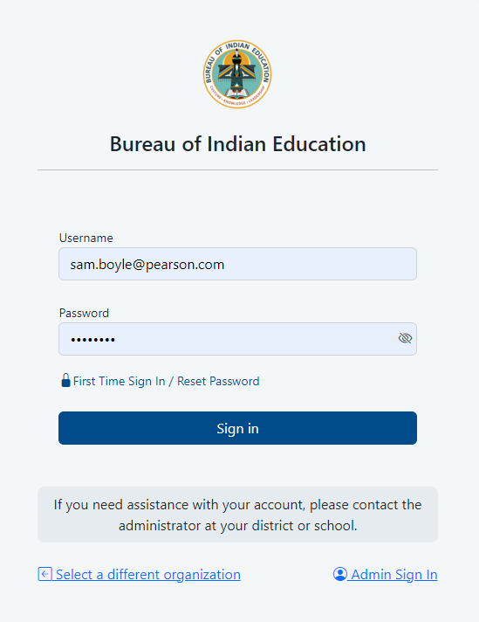
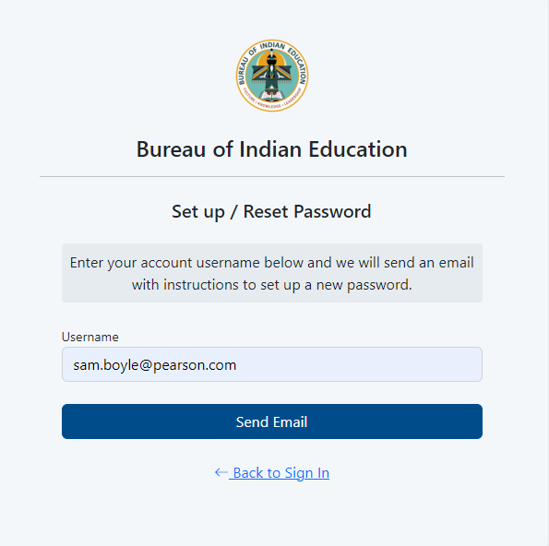
LaunchPad – Forgot Password
If you are having issues logging in use the reset password link.

Slide 39
Accessing LaunchPad
Users can easily access the LaunchPad SSO link at https://bie.mypearsonsupport.com.

Slide 40
ADAM
ADAM is the test management platform used to administer Summative assessments.
ADAM allows users access to the Summative and Training administrations and is also used to create proctor groups and print student test tickets, which students will use to log in into the assessment application TestNav.
ADAM is also the platform for accessing student assessment results and reports. More information on results and reporting will be provided later in the training.

Slide 41
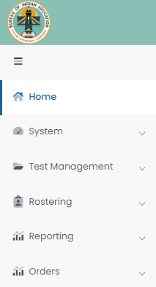
ADAM Menu
Home – Main landing page where Bulletins, including announcements, will be posted.
System – User Profile information can be accessed here.
Test Management – Available test administrations & practice tests can be accessed and administered here.
Rostering – Academic sessions information and Users information can be accessed here.
Reporting – Available reports can be viewed and downloaded here.
Orders – Additional Orders can be placed and tracked here.

Slide 42
User Roles in ADAM
School Admin – principal and/or assistant principal
Test Coordinator
Information Technology
*Teacher – Proctor in ADAM
*Test Administrator – Proctor in ADAM
*Any User that administers tests to students in ADAM is considered a proctor. An active User role in ADAM is not required to proctor/administer a test, only a valid Test Code and Proctor Password provided by the school Test Coordinator. Staff proctoring a test in ADAM will use the credentials provided by their Test Coordinator to login at https://ltr.adamexam.com/#/proctor.

Slide 43
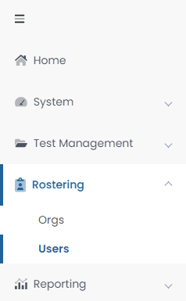
Verifying Users in ADAM
Select Rostering in the menu then select Users and you will see a list of users and last login status in your organization. If a user’s last login status shows Never, that means they have not yet accessed the platform. If any current staff do not have access to ADAM, they should be added to NASIS. If any former staff that no longer serve BIE schools still have active User accounts, their record should be deleted from NASIS.

Slide 44
Rostering in ADAM via API
Beginning with the 2024-25 school year, roster data will be loaded automatically into ADAM through LaunchPad. All Student User information will be pulled from NASIS through an application programming interface (API).
These API roster imports will include:
New students.
Student transfers (school to school or district to district).
Data updates (DOB, name, demographic information).
NOTE: Accommodations will NOT be updated via roster imports; it is the responsibility of the school Test Coordinator to update accommodations in ADAM.

Slide 45
Rostering in ADAM via API
Each school will need to set up an individual API connection between your NASIS/Infinite Campus instance and LaunchPad to initiate rostering between LaunchPad and ADAM. With this API connection in place, roster data will flow automatically. Any updates made in NASIS will automatically update in ADAM within 24 hours.
If your school participated in Interim testing or has used Navvy, no additional API setup is required.
Step-by-step instructions for setting up this API connection can be found at https://bie.mypearsonsupport.com/technology-setup/.
NOTE: Students will NOT be available in ADAM until the API setup is completed by the school and until Pearson has configured the API to begin passing roster data from NASIS to LaunchPad to ADAM.

Slide 46
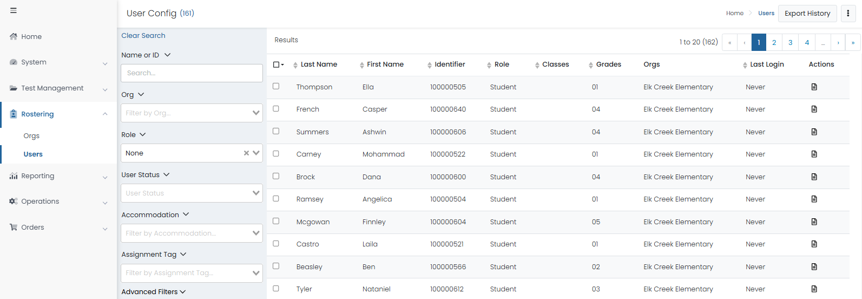
Viewing Roster Data in ADAM

Slide 47
Students in ADAM
Viewing Student Demographics
On the Users screen, you will be able to view the list of all Students uploaded to ADAM for your organization.

Slide 48
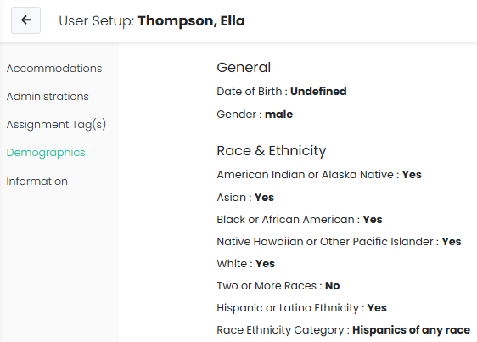
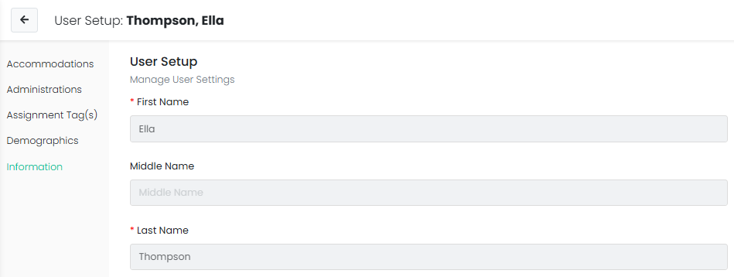
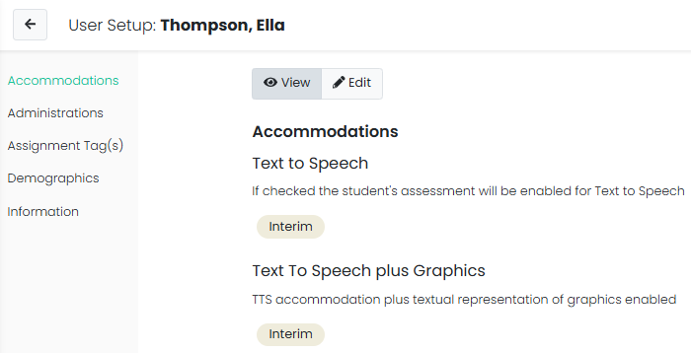
Student User Setup Page
Users with the Test Coordinator role will have access to Student roster information and can use the User Setup screen to view demographic data and confirm and update accommodations.

Slide 49
Export Users in ADAM
Select Rostering
Select Users
Select the specific student and/or non-student users for export
Click the kabob menu in the upper right and select Export Selected Users

Slide 50
Verify & Update Student Accommodations in ADAM
All students MUST have accommodations updated by January 31, 2025, in ADAM.
This is very important as this data drives the initial orders sent to your schools for Online and Paper tests, manuals, and accommodated materials.
Once the API connection between NASIS & LaunchPad is in place, Test Coordinators will need to:
Verify all Student data loaded is accurate.
Update or add student accommodations.

Slide 51
Accommodations in ADAM
Accommodation | ELA/Math | Paper/Online
American Sign Language | Both | Online
Read Aloud / Human Reader | Both | Online/Paper
Screen Reader | Both | Online
Non-Screen Reader | Both | Online
Closed Captioning | ELA | Online
Human Signer | Both | Online/Paper
Text To Speech | Both | Online
Student must have a 504 or IEP for assigned accommodations

Slide 52
Accommodations in ADAM
Accommodation | ELA/Math | Paper/Online
Braille plus Tactile Graphics | Math | Online Test & Paper Tactile Graphics
Answer Masking | Both | Online
Color Contrast | Both | Online
Braille​ | Both | Paper
Large Print | Both | Paper
Paper | Both | Paper
Student must have a 504 or IEP for assigned accommodations

Slide 53
Accommodated Forms Hierarchy
Students with multiple accommodations will be assigned to a form that supports all or most of their form determinant accommodations as outlined in the table below.
Online Form Assignment Order | Paper Form Assignment Order
Braille plus Tactile Graphics Human Signer American Sign Language Refreshable Braille / Assistive Technology Closed Caption Text to Speech Read Aloud / Human Reader Screen Reader Non Screen Reader Large Print | Paper Braille plus Tactile Graphics Human Signer Read Aloud / Human Reader Large Print

Slide 54
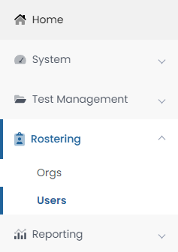
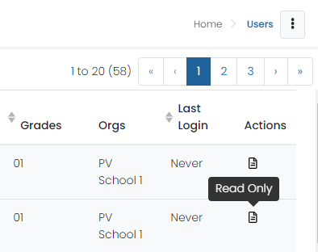
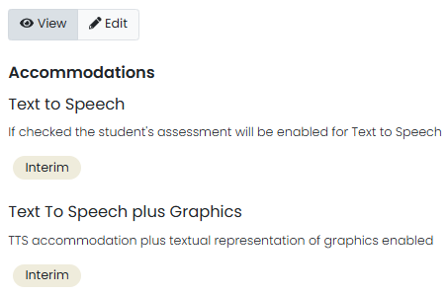
Assigning Accommodations in ADAM
School Test Coordinators will be responsible for applying student accommodations prior to testing. Accommodations can be applied to the Student record or in bulk via a data import using the Student Accommodation Upload option.

Slide 55
Student Accommodation Upload in ADAM
Select Rostering, then select Users.
Search for the students you want to view or update (set the Role filter to "Students"). You can search for all the students in a school or a single grade.
Select the checkbox in front of each student you want to update. You can select the checkbox at the top of the list to select all students in the search results or on the current page.
Select the ellipses on the top right, then select Student Accommodation Upload.
Follow the on-screen instructions on the Student Accommodation Upload and Update Students via CSV page.

Slide 56
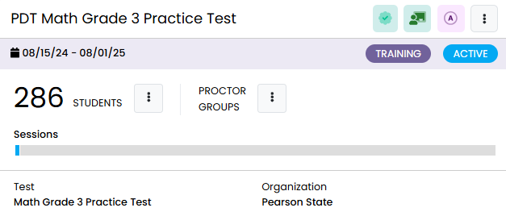
Test Administrations in ADAM
Test administrations will be set up in ADAM by Pearson. BIE Principals, school Test Coordinators, and IT staff will be able to view admins.
Administrations in ADAM feature three sections:
Students – a list of all eligible students for a particular test.
Proctor Groups – view or create testing groups.
Sessions – view student progress.

Slide 57
Training Administrations in ADAM
Training administrations, or practice tests, are available by navigating to Test Management, then Training Administrations. These training admins can be used to proctor secure practice tests, including for the Infrastructure Trial.

Slide 58
Proctor Groups
Proctor groups in ADAM are groupings of students, created by school Test Coordinators, that will be tested together and/or be tested by the same test administrator or proctor.
Students can be grouped by:
Class
Administration consideration (i.e. small group)
Subject (i.e. Algebra I)

Slide 59
Proctor Groups – Paper-based Testing
Students who will be testing Paper do NOT need to be added to a proctor group in ADAM.
All Paper-based testing students will need is the Paper accommodation applied to their record in ADAM.
If a student assigned the Paper accommodation in ADAM needs to test Online, the Paper accommodation must first be removed.
Students testing high school math on Paper will automatically be assigned Algebra II using the assignment tag. Test coordinators will need to update the assignment tag on the Student record in ADAM for any student that will not be taking Algebra II.

Slide 60
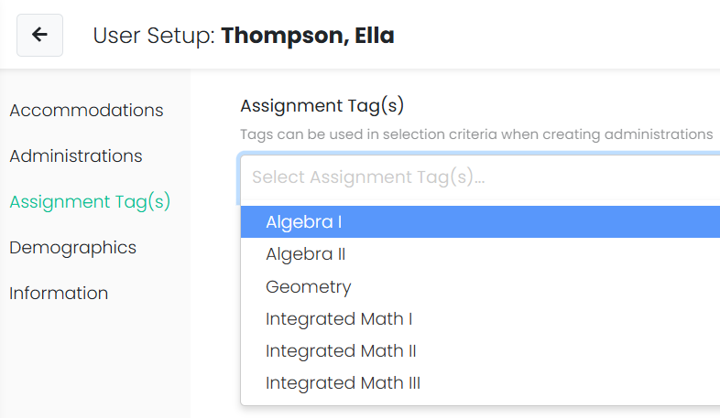
Assignment Tags in ADAM
Assignment tags must be applied to grade 11 students in ADAM requiring a Paper-based test to denote which high school Math test they should take by January 31, 2025.
Assignment tag options include:
Algebra I
Algebra II
Geometry
Integrated Math I, II, or III
To modify an assignment tag, navigate to the User Config page, select Assignment Tag(s), then select the appropriate option from the dropdown menu.

Slide 61
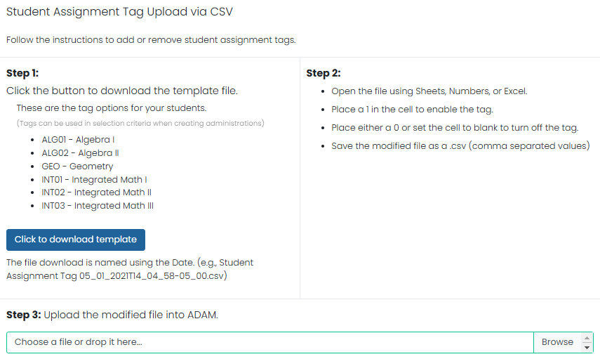
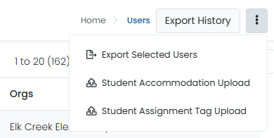
Assignment Tags in ADAM
To add assignment tags to multiple students, download a template pre-populated with selected students, indicate which students have one or more of these course-based assessments and then upload that file to assign to students.

Slide 62
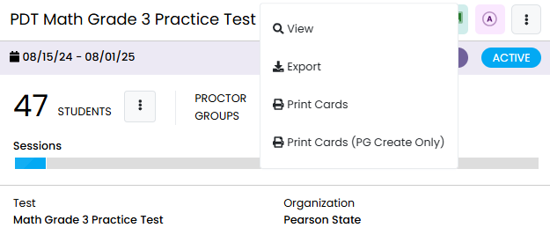
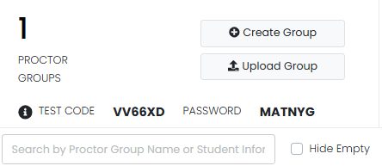
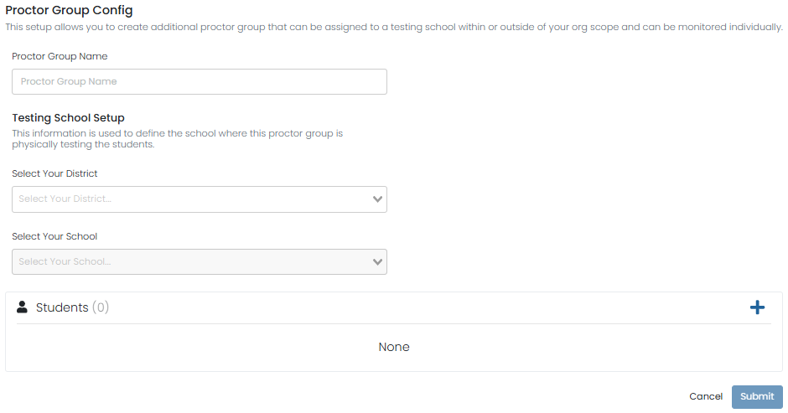
Creating Proctor Groups
To create a new proctor group:
Select Create Proctor Group.
Complete the form for each proctor group you are creating.
If you’re assigning students, click the + button and then select students to assign to the proctor group.
Click Submit to save the new proctor group.
Once proctor group(s) are created the Test Coordinator can then provide each proctor with the unique test code and password for proctor login.

Slide 63
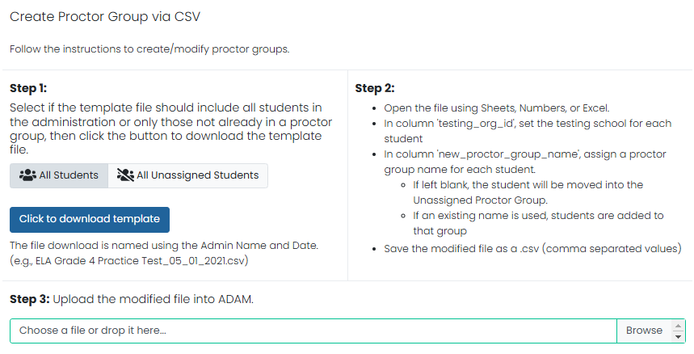
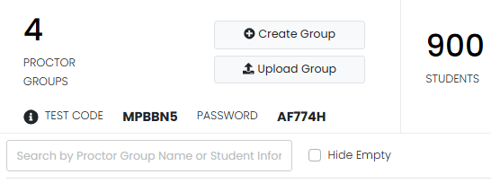
Proctor Group Upload
As an alternative to creating each proctor group in the ADAM user interface (UI), Test Coordinators can also use the Upload Group option to create proctor groups through a bulk file upload.
After selecting Upload Group, you’ll be taken to a new screen that provides step-by-step instructions on downloading the template file, updating the file, and uploading into ADAM.

Slide 64
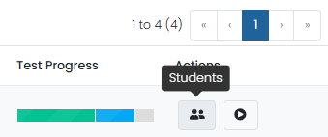
Add Students to Existing Proctor Groups
Go to Test Management and select Administrations.
In the appropriate administration card, select View under Proctor Groups.
Select Students under Actions.
Select Edit Proctor Group.
Select the + icon to assign additional students to the proctor group.
64

Slide 65
Student Registration
Go to Test Management, then select Administrations.
On the proctor dashboard, it will display the total registered Student count for that given administration.

Slide 66
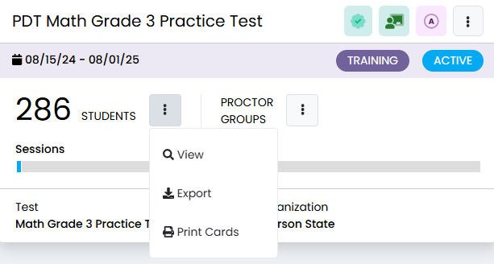
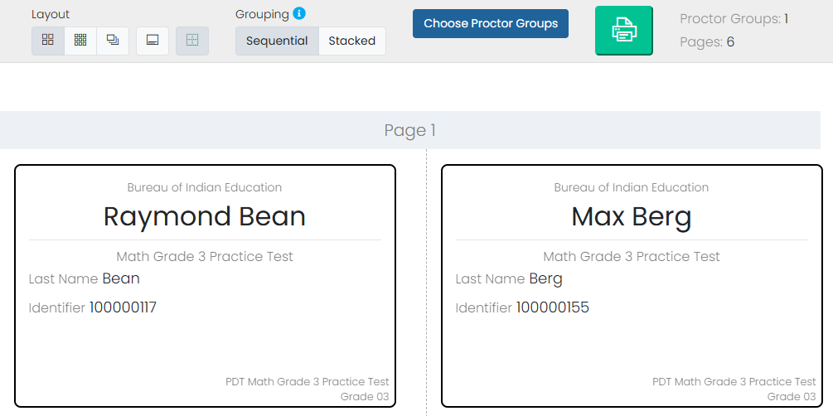
Printing Test Cards
Locate the administration card, and then under either Students or Proctor Groups select Print Cards.
You can select various formatting options:
Layout - Select 2 by 4, 3 by 6, or 1 per page.
Toggle title pages for each proctor group - Select whether to include title pages for each proctor group. This prints a roster for the proctor.
Toggle borders - Select whether to include dashed borders (guides for cutting the cards).
Grouping - Sequential or Stacked. Select the information icon to see formatting conventions for each option.
Select the Print button.

Slide 67
Before Testing Checklist
67

Slide 68
Test Coordinator Tasks
Confirm that the TestNav app has been downloaded/updated for all devices.
Confirm that all devices can connect to the school network.
Unpack Secure and Unsecure test materials.
Conduct an Infrastructure Trial.
Review the Test Coordinator Manual and Test Administration Manuals.
Review the Accessibility Features and Accommodations Manual (AF&A).
Train teachers and staff on testing expectations.
Print student test tickets.

Slide 69
Test Security
Materials are kept in a central, secure, and locked location with limited access.
No duplication of secure materials is permissible.
All involved personnel understand security protocols.
All involved personnel have signed security agreements. (https://bie.mypearsonsupport.com/training-resources/).
Test environments are secured against unauthorized personnel.
Use a chain of custody (https://bie.mypearsonsupport.com/training-resources/).

Slide 70
Test Materials Security
Secure
Student test tickets
Paper-based test booklets
Paper-based answer documents
Human Reader Math scripts
Used scratch paper
Any student work/responses
Mathematics reference sheets (prior to testing)
Any material written on that cannot be reused
Non-Secure
Test Administrator Manuals (TAM)
Test Coordinator Manual
Unused scratch paper

Slide 71
Initial Shipment of Test Materials
Initial shipments of test materials will be received 1-2 weeks prior to the test start date.
You MUST have all student accommodations updated and assignment tags added for grade 11 students taking Paper-based Math tests in ADAM by January 31, 2025, to ensure you receive the appropriate testing materials.
Pre-ID labels, stickers with scannable barcodes that can be placed on student Paper answer documents containing student information, will only be shipped with the initial shipment of test materials and cannot be ordered through the additional order process.

Slide 72
Initial Shipment of Test Materials
Test Coordinator Kit
Resealable plastic bag (holds all materials)
Paper bands
Pearson Scorable and Nonscorable labels (2 different colors)
UPS Ground return labels for Scorable and Nonscorable materials
Pre-printed/pre-gridded test booklet
Student pre-ID labels and roster
Return instructions sheet
Shipping carrier return instructions
Packing list and chain of custody form
Test Coordinator Manual
Test Administrator Manuals
Student test materials
Test booklets/answer documents
Math Reference Sheets, rulers, and protractors, if applicable
Large Print/Braille kits
Human Reader kits

Slide 73
Initial Shipment of Test Materials
Accommodation | Students testing Online | Students testing Paper
Text to Speech | Student receives a form that has text to speech tools available. No other materials are needed for the student. | N/A
Human Signer - Math | Human Reader script is shipped to school that includes same questions as the online human reader test. | A Human Reader Kit is sent to school. Kit contains: Student test book, student answer document, ruler-protractor-math reference sheet as needed, a math human reader script.
Human Signer - ELA | N/A | A Human Reader Kit is sent to school. Kit contains: Two (2) Student test books, student answer document.
Human Read Aloud - Math | Human Reader script is shipped to school that includes same questions as the online human reader test. | A Human Reader Kit is sent to school. Kit contains: Student test book, student answer document, ruler-protractor-math reference sheet as needed, a math human reader script.
Human Read Aloud - ELA | N/A | A Human Reader Kit is sent to school. Kit contains: Two (2) Student test books, student answer document.

Slide 74
Initial Shipment of Test Materials
Accommodation | Students testing Online | Students testing Paper
American Sign Language | Student receives a test form with embedded videos of American Sign Language. | N/A
Closed Captioning (ELA only) | Student receives a test form with closed captioning and a transcript for any included videos. | N/A
Refreshable Braille Display | Student receives the assistive technology Non Screen Reader form. | N/A
Assistive Technology Screen Readers | Student receives the assistive technology Screen Reader form and a Braille kit will be sent to the school for the student. | N/A
Braille plus Tactile Graphics | Student receives the assistive technology screen reader form and a Braille kit will be sent to the school for the student. | N/A
Large Print | N/A | A Large Print Kit is sent to schools. Kit contains: Student test book, student answer document, ruler-protractor-math reference sheet as needed, a math human reader script.
74

Slide 75
Receipt of Test Materials
Upon receipt of test materials, Test Coordinators should:
Remove the Packing List, chain of custody Form, and Test Coordinator Kit from Box 1.
Inventory materials immediately to verify that all were received and that there is an adequate number for administration.
Count the number of shrink-wrapped packages only. Shrink-wrapped packages may be opened four school days before testing.
Optional: take labels out of School Coordinator Kit
Test Coordinators may order additional material, if necessary.
Keep all test materials in a centrally locked storage area, with limited access, until testing.
Ensure that chain of custody procedures are always followed.

Slide 76
Receive Materials & Chain of Custody Forms
Document any movement of secure materials before, during, and after testing.
Schools inventory materials using the chain of custody.
Deliver paper-based forms and materials (oral scripts) to Test Administrators only on the day of testing, using a chain of custody process.
Distribute only the content area being assessed.
As close to testing time as possible
Return materials to a designated secure location.
Not stored in classrooms
As soon as possible after the unit is complete
Test Administrators return secure materials to Test Coordinator after testing is completed, including Math Human Reader scripts.

Slide 77
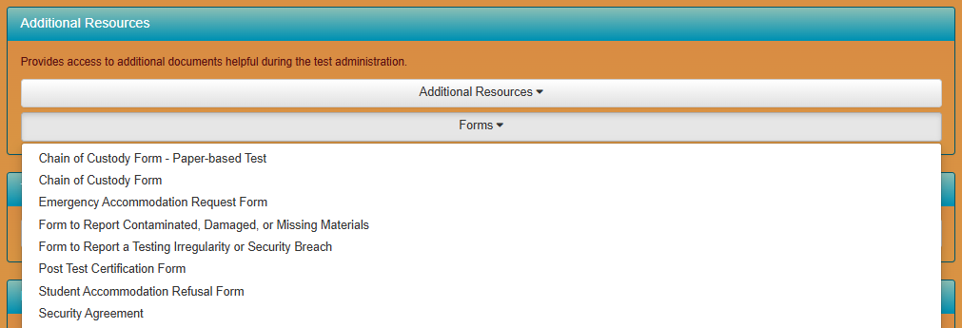
Chain of Custody Forms
Use a new school chain of custody form for each day of testing the form must include:
Security barcode/number
Test Administrator signature
Date and time checked out
Test Coordinator (or designee) signature for return
Date and time returned
Chain of custody forms are kept on file for three years. If materials are missing, these will be requested.

Slide 78
Documenting & Storing Test Materials
Keep all boxes in which the test materials were delivered and use them to return Scorable and Nonscorable materials after testing is completed.
Report the following occurrences immediately to BIE using the Form to Report Contaminated, Damaged, or Missing Materials (see Appendix E of Test Coordinator Manual):
Non-receipt of any materials listed on the School Packing List
Discovery of damaged test material
Discovery of missing or duplicate sequence numbers on any Test Booklets

Slide 79
During Testing Tasks
79

Slide 80
Additional Order Window
Summative Additional Order (AO) window:
Order at least 5 days prior to test administration, but after the initial order is received.
It is the school Test Coordinator’s responsibility to understand the additional order window and return dates and process.
 | Dates
Additional Order window | March 3 – April 25, 2025
Return Materials (Secure) | April 25, 2025
Return Materials (Non-Secure) | May 2, 2025

Slide 81
Additional Orders
Orders can be only be submitted in ADAM by the Test Coordinator.
BIE will only approve additional orders for accommodated materials if the ordered materials can be matched to a student registration in ADAM.
Accommodations information must be entered on the student's profile before placing the additional order.

Slide 82
Additional Orders
Keep in mind when ordering additional material:
Do not submit AOs prior to receiving the initial shipment of test materials.
PreID labels for Paper tests will NOT be sent with AOs.
All test materials should be inventoried prior to placing an AO.
Once an AO is approved, please allow 4-5 business days for shipment and delivery.

Slide 83
Additional Orders
Keep in mind when ordering additional material:
Ancillary materials for return shipping are not automatically included in the AO.
Shipping labels
Mathematics tools and Reference Sheet
Account for the need of these additional materials when an AO is placed.
Check for return labels prior to the end of the testing window as these will not have expedited shipping.

Slide 84
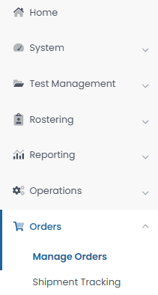
Creating Additional Orders
To place an additional order in ADAM:
Select Orders, then select Manage Orders.
Select Create Order.
Fill out all required information for the new additional order on the Order Details screen, then select Go to Order Items.
Add all needed items and item quantities, then select Go to Confirm Order.
Confirm the details and items for your additional order, then select Approve Order.

Slide 85
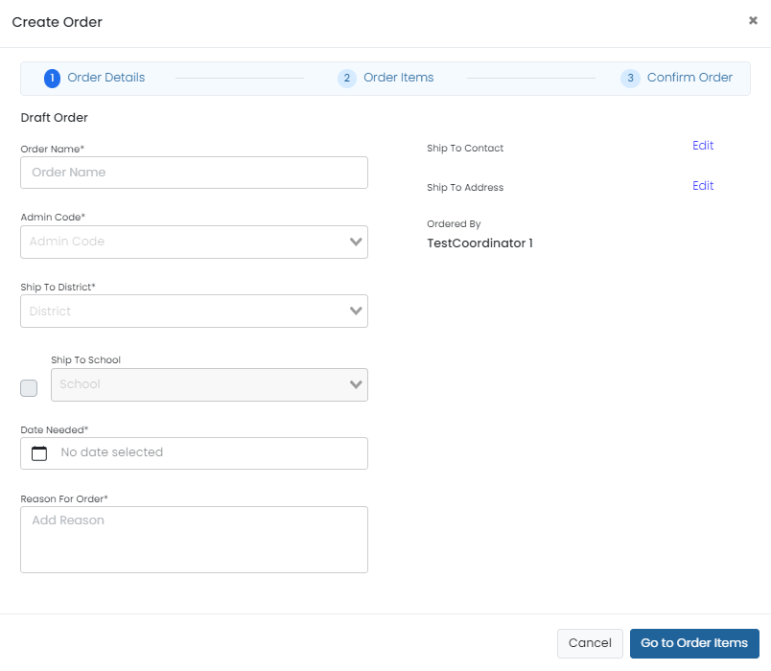
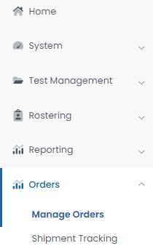
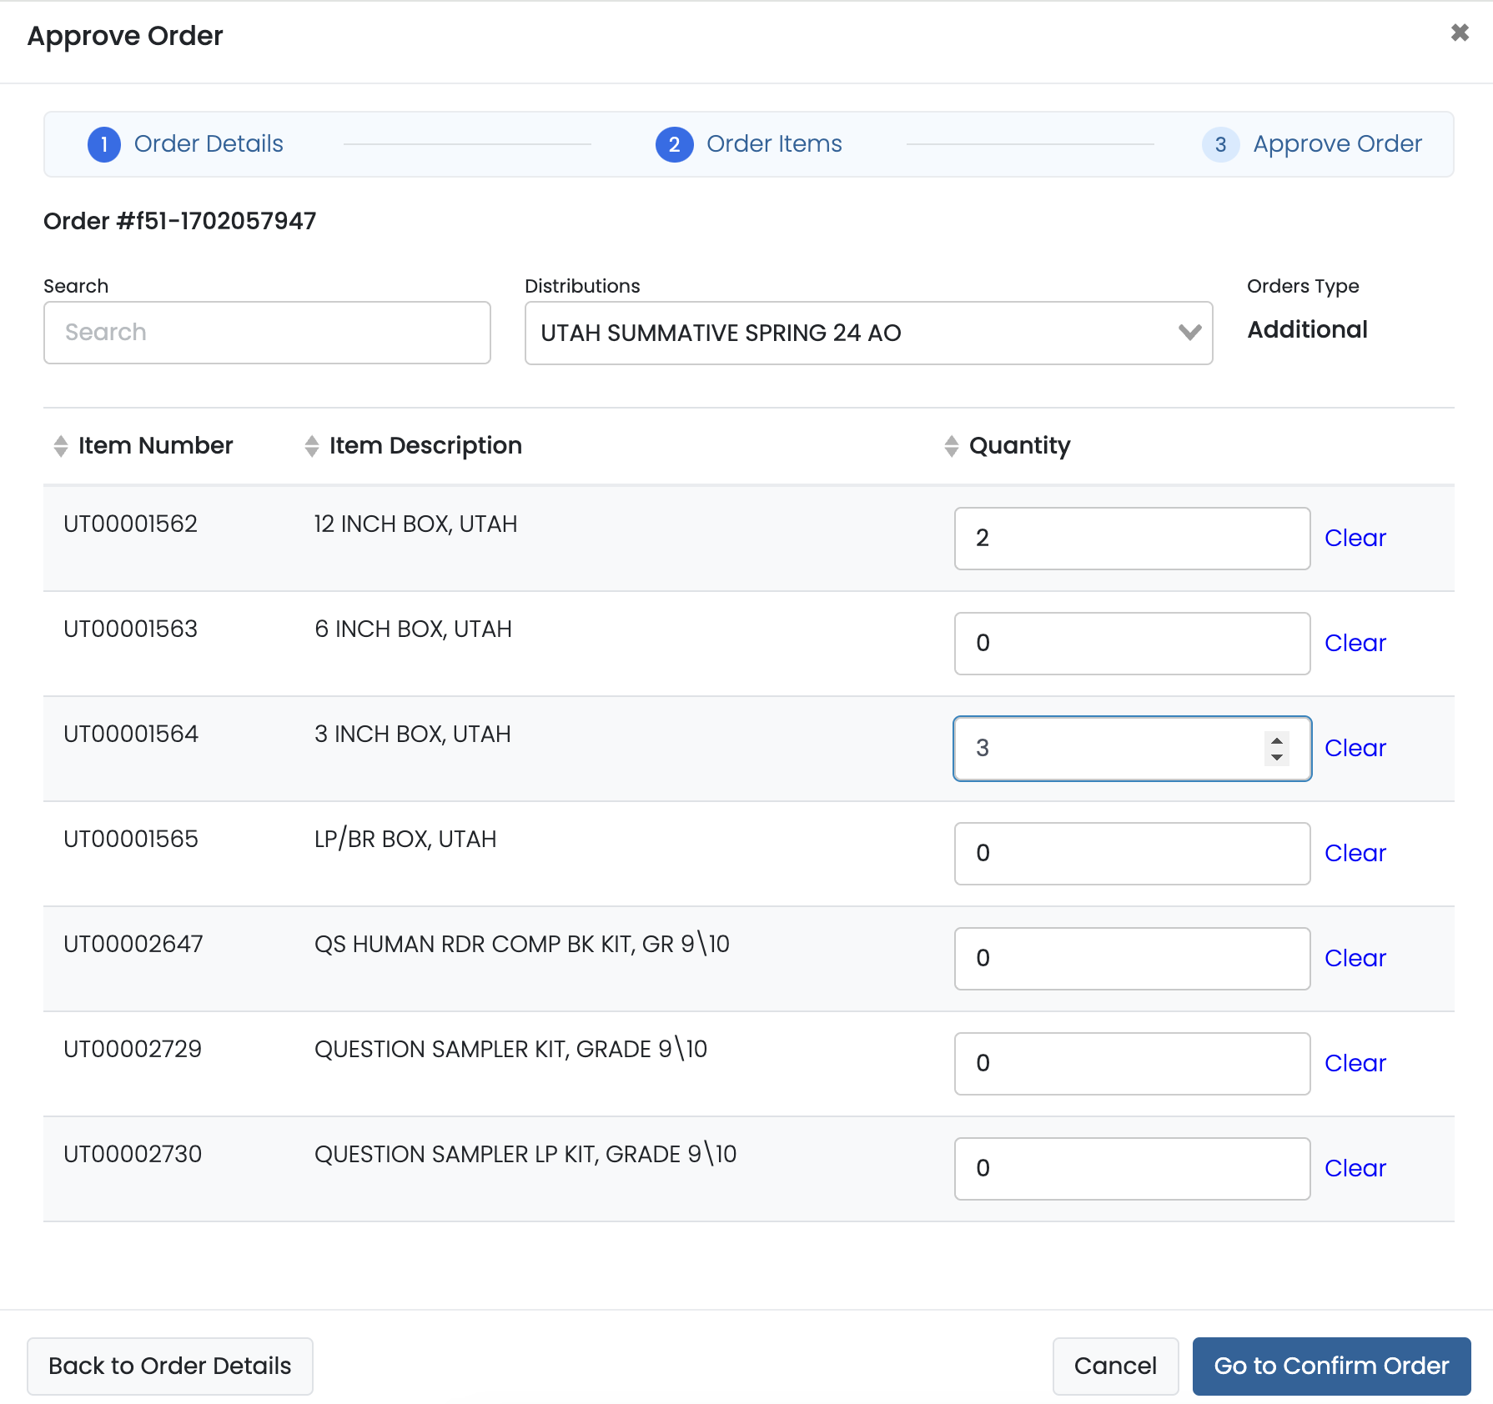
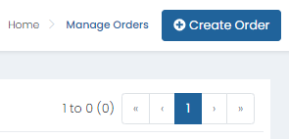
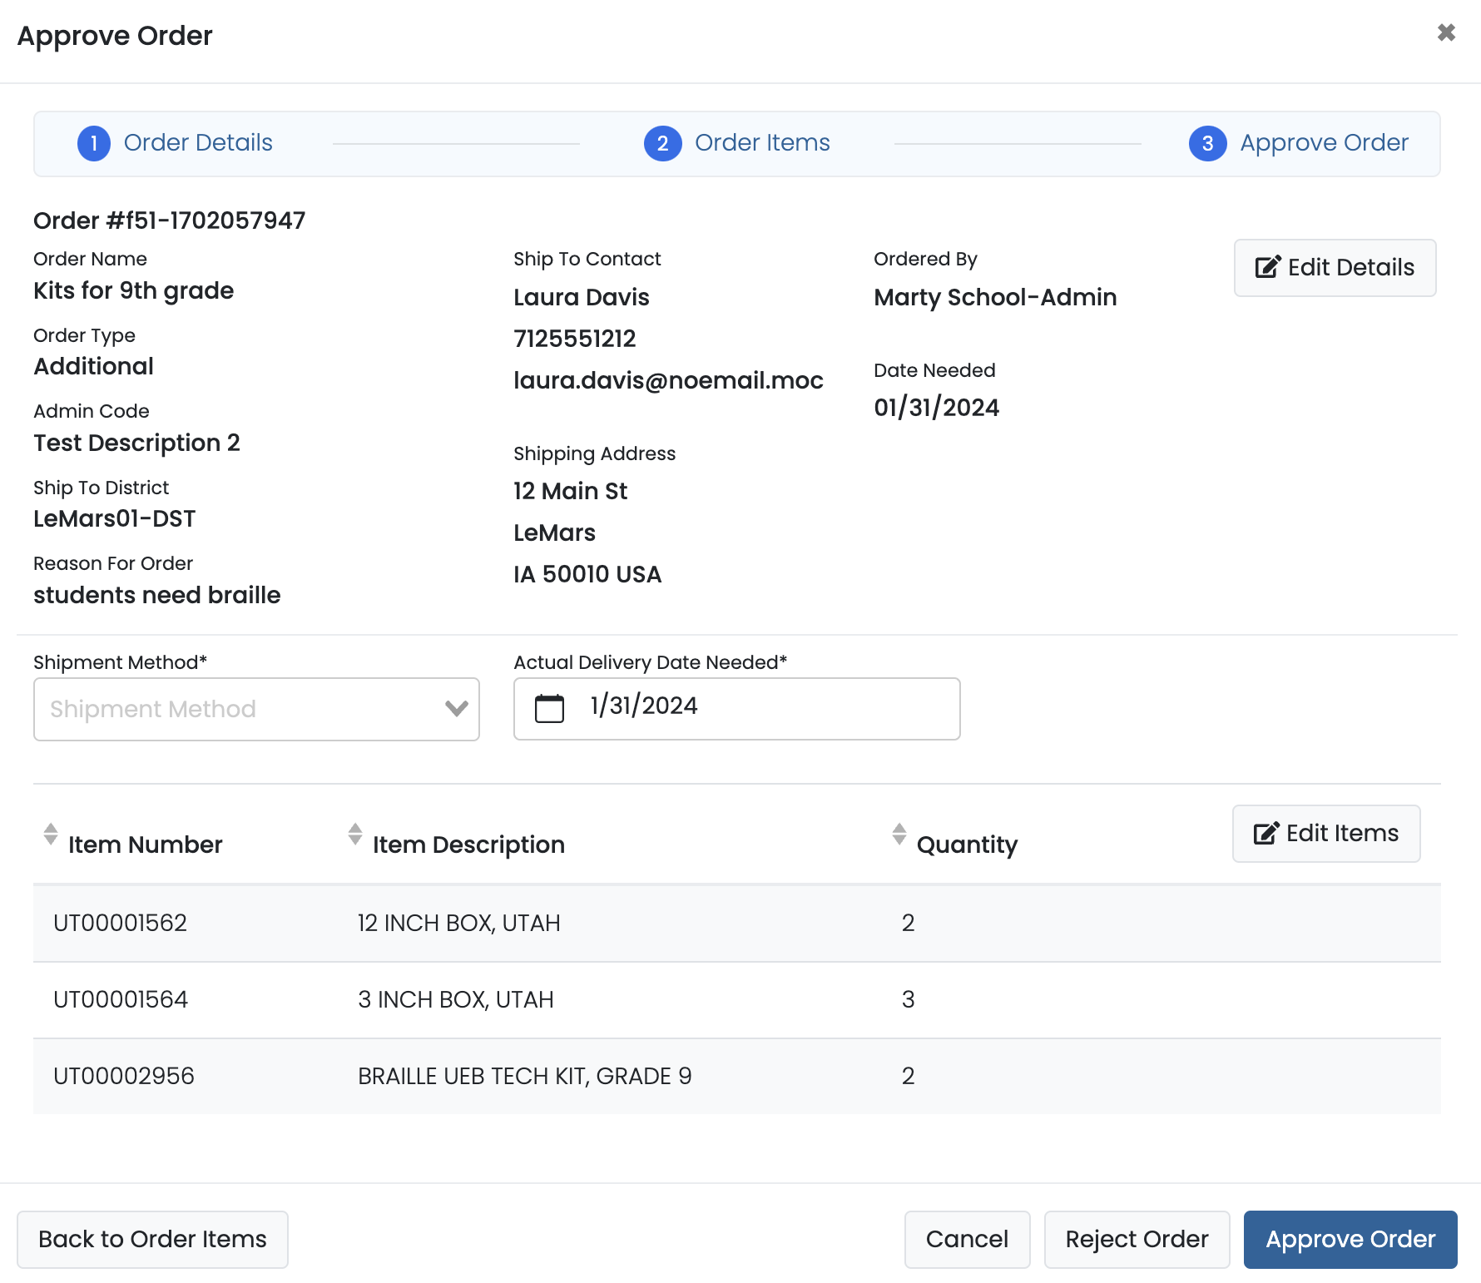
Creating Additional Orders

Slide 86
Proctoring in ADAM
School staff proctoring/administering Summative tests in ADAM will NOT have a user profile in LaunchPad.
Test administrators, teachers, and any certified staff proctoring tests will access the ADAM proctor dashboard by logging in at https://ltr.adamexam.com/#/proctor.
The proctor dashboard allows proctors to approve & begin student tests, monitor test session progress, create temporary student records as needed, and update student statuses as needed.
Test Coordinators will also be able to access proctor dashboards for all proctor groups created at their school.

Slide 87
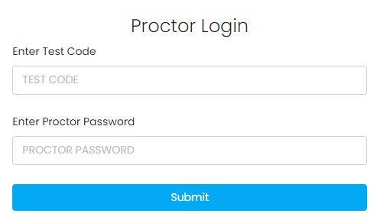
Proctor Login
Navigate to https://ltr.adamexam.com/#/proctor.
Enter the test code & proctor password (provided by the Test Coordinator).
Select Submit.

Slide 88
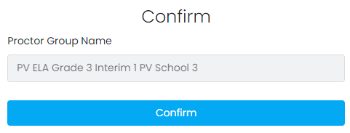
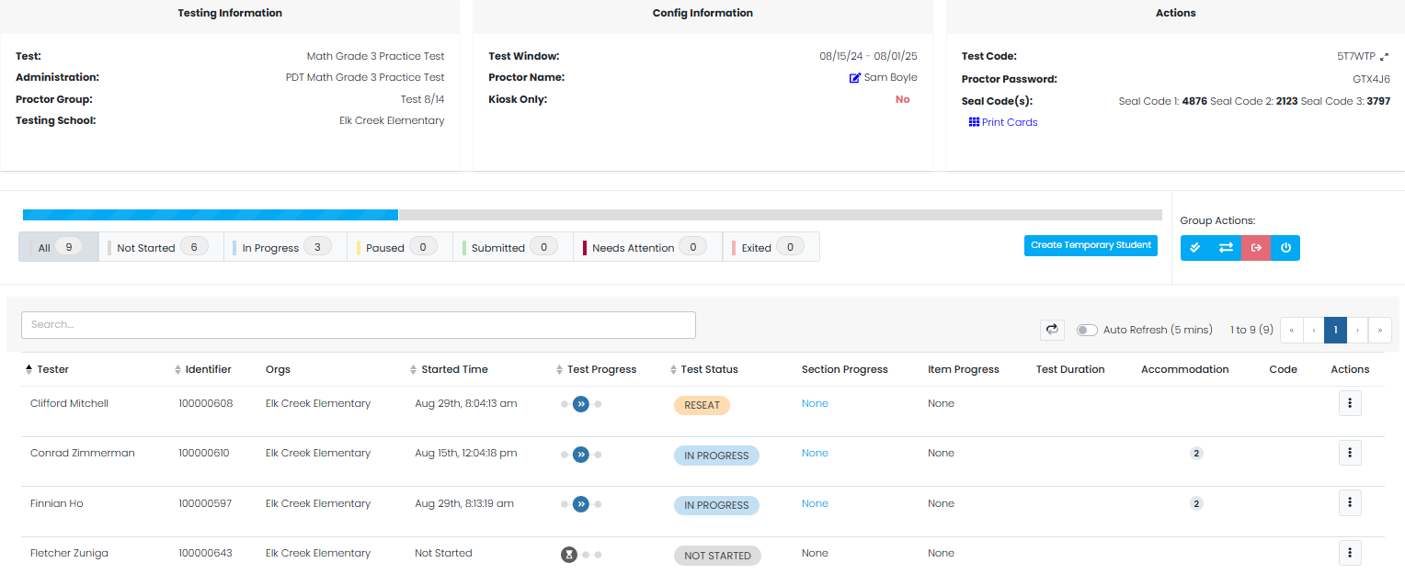
Proctor Login
Select Confirm on the next screen.
Type your proctor first name & last name.
Select Save.
Proctor dashboard will then load.

Slide 89
Monitor Proctor Groups
School Test Coordinators can monitor student testing status by selecting View under Proctor Groups on the admin card, then selecting Proctor under Actions for a particular proctor group. This will take you to the proctor dashboard for that proctor group.

Slide 90
During Testing – ADAM Proctor Dashboard

Slide 91
Proctor Dashboard Details
Assessment Information – Here you can view information about the test, test configuration, and select an action.
Testing Information – Includes Test, Administration, and Proctor Group
Config Information – Includes Test Window, Proctor Name, and Kiosk Only field
Actions – Includes Test Code, Proctor Password, Seal Codes, and Print Cards link
Student Session List – Here you can view, filter, search for students in your proctor group and manage their sessions and apply accountability codes as needed. Students that can access the test appear in the Tester column.

Slide 92
Proctor Dashboard – Test Status
The Test Status column displays the students’ progress as one of the following:
Not Started – The student has not signed in to test. No action is needed by the proctor.
Needs Attention – The student requires action by the proctor, such as needing their test approved by the proctor.
In Progress - The student has signed in to the test. No action is needed by the proctor.
Submitted - The student has completed the test and submitted their answers.
Reseat – The proctor has reseated the student. The student has not yet signed back in to the session. No action is needed by the proctor.
Exited - The student has exited TestNav and the proctor must reseat them before they can log in to the test again.
Resumed – The student has resumed their test session.

Slide 93
Proctor Dashboard – Actions
After the assessment session has started, a set of options appears in the Actions column for each student. Proctors use these options to control individual student’s sessions:
Approve Session – Proctors will need to select Approve Session for any student with a Needs Attention progress status for the student to begin their test in TestNav.
Reseat Session – Proctors can select this if a student exits TestNav before submitting their test or if something interrupts a student's session. This might include a computer issue, session timeout, or an unexpected error. Reseating allows the student to re-enter their test code and SSID to continue taking their test.
Submit Session - Proctors can select this if a student finishes their test but does not submit the test before exiting.
Unsubmit Session - Proctors can select this if a student mistakenly submits their test.

Slide 94
Proctor Dashboard – Move to Section
Spring Summative tests are multi-section/multi-unit assessments, so proctors have the option to define the section/unit a student starts in. Once the proctor moves a student, the next time the student logs into the test they will start in the new section/unit.
All students can be moved to the same section in bulk using the Move All to Section button in the header of the Proctor Dashboard, or students can be assigned to start in a section using the Move to Section action in the kabob menu.

Slide 95
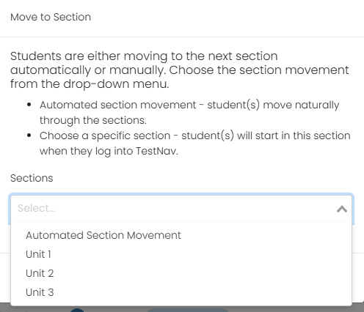
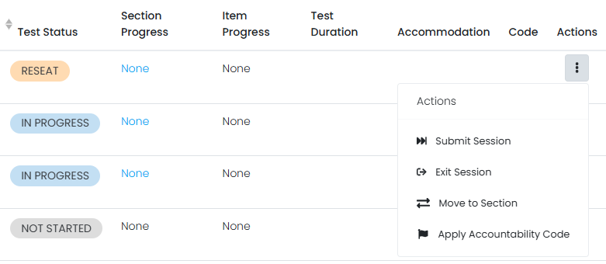
Proctor Dashboard – Move to Section
Proctors or Test Coordinators should only move students to a specific section or unit of a test for the following reasons:
A student was absent for a day of testing and needs to start on a specific section/unit to test with their proctor group.
A student completed certain sections/units of the test during scheduled testing time but was unable to complete the test due to unforeseen issues, such as an illness, and will need to finish during scheduled makeup testing.

Slide 96
Temporary Student Records
If a student enrolled at your school does not have a record in ADAM, a temporary record can be created in the proctor dashboard.
A temporary record will need to be created for each test the student takes.
When creating a temporary record, a unique ID will need to be applied.
Pearson recommends using the student’s NASIS ID + a unique identifier (i.e. NASIS ID – 123456789 + G3Math).
Once a permanent record has been created in ADAM for the student, all temporary records will be merged to the permanent record by the BIE.

Slide 97
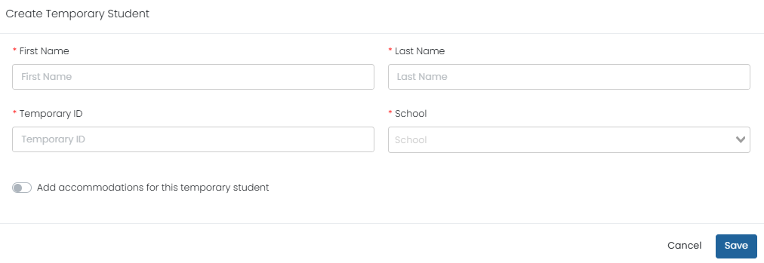
Creating Temporary Students
To create a temporary student record in ADAM:
Navigate to the proctor dashboard where the student will test.
Select Create Temporary Student
Add the students First Name, Last Name, Temporary ID, and School.
If applicable, select Add accommodations for this temporary student and add all needed accommodations.
Select Save.

Slide 98
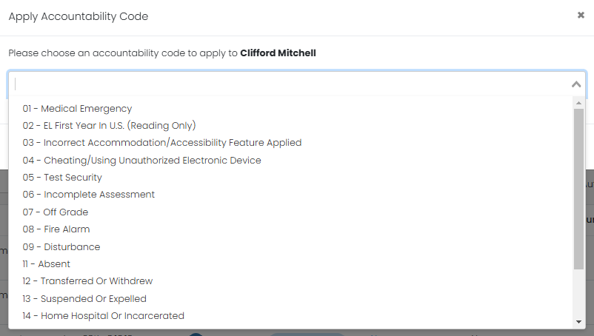
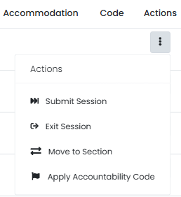
Accountability Codes
Accountability codes provide a way for designated users to tag students who should not test, or who were tested but should not appear in reporting. The available codes, what they do, and who can add them depends on your site implementation. These can be applied in the proctor dashboard or from any administration student list.

Slide 99
TestNav
99

Slide 100
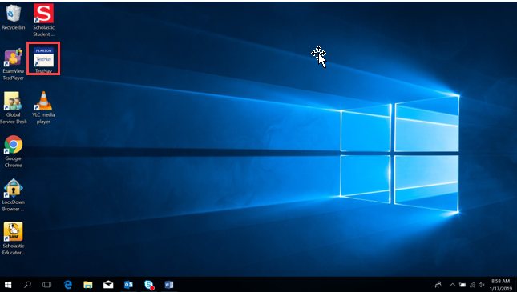
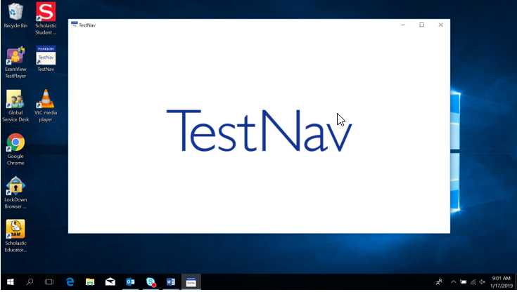
TestNav – Student Access on a Windows device
Students will select the TestNav icon from their computer desktop.

Slide 101
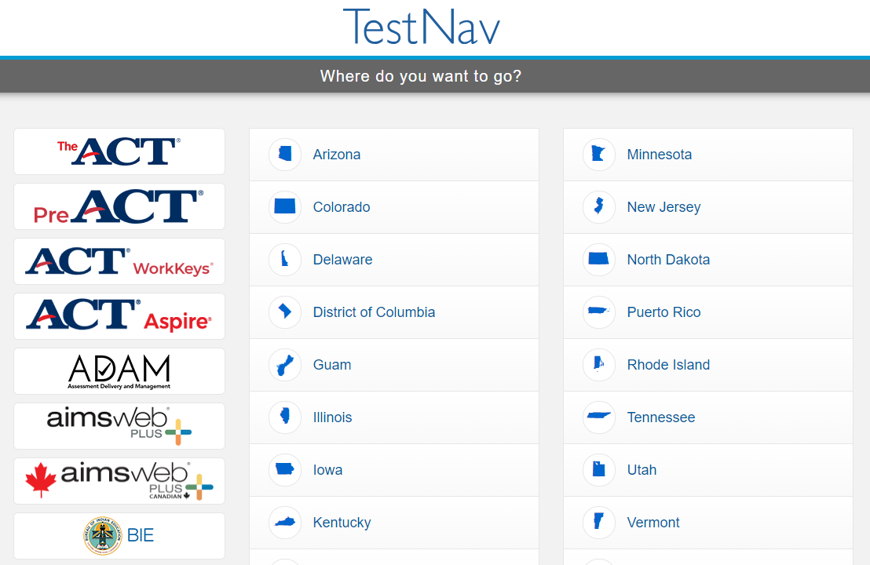
TestNav Access
If not already chosen, students will need to select BIE from the customer list.

Slide 102
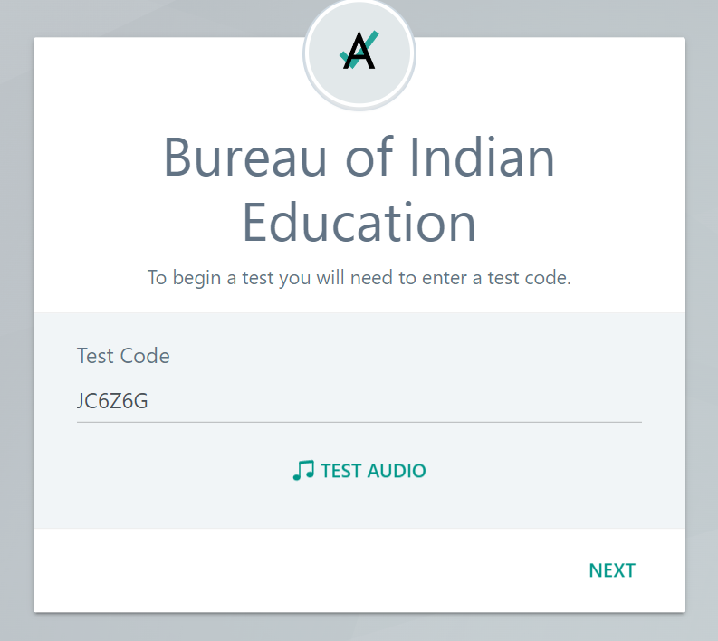
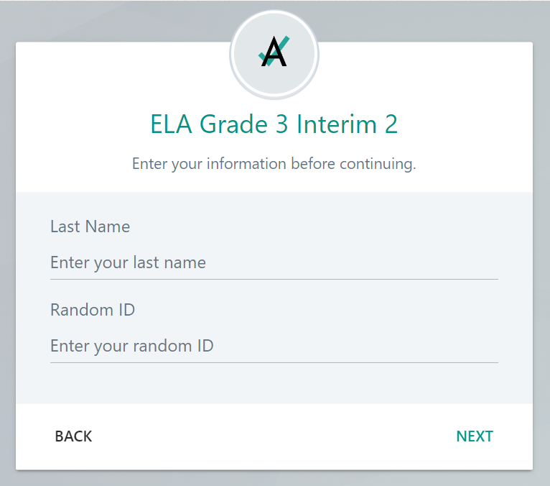
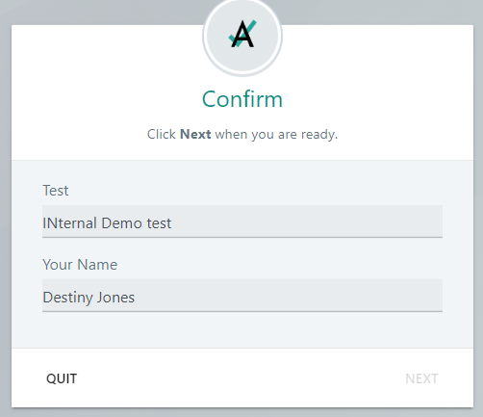
TestNav Sign-In
Students input the Test Code provided by the proctor & Last Name and NASIS ID from their test ticket. The student will then confirm the information is correct and select next to begin their test.

Slide 103
TestNav Blocklist
The TestNav application will be blocked from opening if any of the below applications are running on a student device:
Firefox
Google Chrome
Internet Explorer
Safari
Microsoft Edge
Cisco Webex
Cisco Jabber
Citrix GoToMeeting
Facebook Messenger
Yahoo Messenger
Google Talk
Outlook
Snap Chat
Skype
Teams
WhatsApp
Zoom
Amazon Music
iTunes
Pandora
iHeartRadio
Spotify

Slide 104
TestNav Troubleshooting
If Students are experiencing issues logging into their test in TestNav, here are some common troubleshooting tips:
Confirm the student is using the login information provided on their test ticket.
Check to see if the student is in a Needs Attention status in the proctor dashboard and, if so, approve their test.
Confirm that no blocked applications are currently running on the student’s device.
Ensure that your school’s network is stable and ready to support Computer-based testing (perform the recommended Infrastructure Trial prior to testing or work with IT staff if available).
If a student login to TestNav fails or if a student exits the test Reseat the student in the proctor dashboard.
If issues persist, take note of the error code or error message provided in TestNav and contact Pearson Customer Support.

Slide 105
During Testing Checklist
105

Slide 106
Test Environment
The testing environment must:
Be adequately lit, quiet, free of distractions, and heated or cooled.
Provide an adequate writing surface (Paper-based).
Be free of electronic devices and music.
“Do Not Disturb/Only Authorized Personnel Allowed” sign must be placed on the door during test sessions.

Slide 107
Test Environment
No food or drinks are allowed on desks or near test materials.
The testing environment must be free of any content related posters or aids that suggest possible answers to students:
Word walls.
Steps for solving math equations.
Any content related materials.
Any resource that defines, explains, or illustrates terminology or concepts.
As a general rule: When in doubt, cover it.

Slide 108
Student-to-test Administrator Ratio
Student-to-Test Administrator ratio must not exceed 30 to 1.
Test Administrator must be able to actively monitor the space within the physical testing environment.
Test Administrators must:
Actively proctor.
Remain attentive and in the room during the entire testing unit.
Circulate throughout the room during the test.
See students working but not see student work.

Slide 109
Display Testing Time
Display unit testing time for students as in the example below:
 | Algebra 1, Unit 1
Unit Testing Time: | 90 Minutes
Starting Time: | 9:00 AM
Stopping time: | 10:30 AM

Slide 110
Testing Room Configuration
Students should not be able to see each other’s work from a normal testing position.
Consider the following seating configurations to maintain test security:
Seat students in every other seat (useful in a computer lab setup).
Arrange monitors back-to-back.
Seat students back-to-back.
Seat students in a semicircle (useful for schools using laptops).
Seat students in widely spaced rows or in every other row (appropriate for a classroom setup).
Dividing screens or other privacy materials may be used if students cannot be placed far enough away from each other.

Slide 111
Headphones for Computer-based Testing
ELA
All students must have headphones for all units.
Not every unit has sound, but one unit for each student will.
Students should be prepared follow directions and adjust sound for each unit.
Text-to-Speech for ELA & Math
To be in a testing room with other students, headphones must be worn.
Students must be tested separately if they are not able to wear headphones.
Math
Does not contain audio, unless text-to-speech is used.

Slide 112
Unauthorized Visitors & the Media
Only students, Test Administrators/proctors, and authorized school, district, state personnel, or state-sanctioned test monitors may be in testing areas during administration.
Media are not allowed to have access to the tests before, during, or after test administration, or take pictures or video of testing materials or testing students.
Parents are not allowed in the testing room with their child.

Slide 113
Test Coordinator Tasks
Complete the Day of Testing Checklist
Distribute test materials.
Ensure Test Administrators have a computer device to administer the test.
Monitor test activity.
Be available to Test Administrators.
Collect materials from Test Administrators after each test, as needed.

Slide 114
Test Administrator Tasks
Before Testing
Prepare the test environment and situate the students.
Follow directions and read the script in the Test Administrator Manual (TAM) to initiate the test session.
Hand out student test tickets and scratch paper when directed (by the TAM script).
Assist students in logging into TestNav.
After Testing
Collect student testing tickets and scratch paper.
Confirm students have logged out of TestNav.
Confirm ALL tests are in a Submitted status after final day of testing.

Slide 115
Active Monitoring
Test Administrators/Teachers should:
Ensure students have all necessary materials for each test.
Follow test administration scripts exactly as written.
Move throughout the room during testing to ensure students are on task.
Test Administrators MAY NOT:
Provide feedback or clarify test questions.
Answer content related questions.
Interact with students in any way that would impact student responses.

Slide 116
Testing Exceptions & Security Breaches
When to submit Form to Report Testing Exception or Security Breach:
Students were grouped incorrectly – not same directions or time.
Students were given an incorrect amount of time (more or less).
Students were cheating.
Students used an unapproved accommodation or were not given an accommodation with which they should have been provided.
Math test read to students without the Human Reader / Read Aloud assigne.
Test Administrator did not follow procedures.
PBT students go past stop sign at the end of the unit.
Large number of students involved in a technology related exception.
If technology issues cause testing to not be completed on one day.
Test security has been breached.
Student goes back into a unit on a different day and changes answers.

Slide 117
Testing Exceptions & Security Breaches
Monitoring and reporting security breaches and testing exceptions
All instances of security breaches and testing exceptions must be reported to the Test Coordinator.
Test Coordinator will contact BIE Chief Academic Office immediately upon receiving notification.
Testing Exceptions or Security Breach
Test Coordinator will complete the Form to Report a Testing Exceptions or Security Breach and provide to BIE.
See Appendix D of Test Coordinator Manual.

Slide 118
Contaminated & Damaged Materials
PBT - Contaminated or damaged test materials that must be replaced
Place Student preID label on replacement document or complete entire data grid.
Record security barcode number of both the damaged and the new documents.
Submit the Form to Report Contaminated Damaged, or Missing Materials to BIE.
If possible, transcribe responses from contaminated test material into the replacement. If not, destroy contaminated material according to local biohazards protocols.

Slide 119
Safety Threats & Severe Weather
Test Coordinators create a plan and train staff for safety threats and severe weather.
Test Administrators:
Note the time of the disruption.
Secure test materials as specified in your School Security Plan.
Prepare students for the continuation of the unit and resume students’ tests.
Document the situation in writing.
If the disruption will cause the unit to be carried over into the next day, notify BIE.

Slide 120
Prohibited Devices
ALL personal electronic equipment not related to testing (e.g., cell phones, iPods, personal document scanners, eBooks, electronic pens, smart watches, etc.) is PROHIBITED from the testing environment.
Personal electronic equipment may not be used at any time during testing, including after a student has completed testing or during a break.

Slide 121
Technology for Medical Monitoring
Students who use a phone, tablet or other device to monitor their medical condition may have the device in the testing room.
Documentation of medical necessity must be kept at the school.
Plan for use of these devices must include:
Where the device is located and who has control of the device.
If the student has control, the device must always be visible and may not be used for any other purpose.
Procedures for if/when the device alerts and what action is necessary.
If student must leave the testing environment, follow procedures for students who become ill.

Slide 122
Early Finishers
School Decisions:
Will students be able to leave when they have finished testing? (no minimum time)
Sit quietly?
Read (cannot use any electronic reading devices)?
May students be released to location outside testing area?
What to do when all students are completed with unit?

Slide 123
Emergency Accommodation
A case where a student needs a new accommodation immediately due to unforeseen circumstances.
Cases could include students who have a recently-fractured limb (e.g., arm, wrist, or shoulder); whose only pair of eyeglasses have broken; or a student returning from a serious or prolonged illness or injury.
Emergency accommodation form must be completed and maintained.
Contact BIE if a student requires a paper-based administration.
Refer to Appendix G for Emergency Accommodation Form in the Accessibility Features and Accommodations Manual.

Slide 124
Student Accommodation Refusal Form
If a student refuses an accommodation, the school should document in writing that the student refused the accommodation.
Refer to Appendix H of the AF&A Manual: Student Accommodation Refusal Form.
The accommodation must be offered and remain available to the student during testing.
Test Coordinators should send a copy of the form to parents when a student refuses an accommodation documented in an IEP, 504 Plan, or EL Plan.
Forms are maintained in the student’s record.

Slide 125
Make-up Testing
Students who are absent, become ill, or who can no longer test because of classroom, school, or technical interruptions during originally scheduled units, may utilize make-up testing.
Students may not return to previously answered questions.
Test security and administration protocols apply.
School Test Coordinators will establish the make-up testing schedules for their schools.
ELA/Math units may be taken out of order for make-up testing only.
Different grade level or course make-up tests for a specific content can be administered at the same time in the same room.
Special attention must be paid to unit testing time and teacher direction variations between grade levels.

Slide 126
After Testing Tasks
126

Slide 127
After Testing Key Dates
Rejected Paper test alerts must be resolved in ADAM by May 5, 2025*.
Student test status clean-up must be completed in ADAM by May 9, 2025*.
Online tests in the below statuses should be manually submitted in ADAM.
In Progress
Exited
Reseat
*Incomplete tests will NOT be scored or reported.

Slide 128
Manual Test Submission in ADAM
If at the end of the testing window there are any students still in an Exited, In Progress, or Reseat status, those partial attempts must be manually submitted to be scored and reported.
To determine if any student tests require manual submission, Test Coordinators can review the Sessions information located on the admin card for each individual test administration or use the Progress report.
If any In Progress, Exited, or Reseat student statuses are listed under Sessions, these will need to be manually submitted in the proctor dashboard or in Session Explorer.
Students in an In Progress or Exited status will need to be Reseated before their test can be submitted.

Slide 129
Manual Test Submission in ADAM
Test Coordinators will navigate to proctor dashboard, locate students in an Exited, In Progress, or Reseat status, select Actions, then select Submit Session.
Any student in an Exited or In Progress status will need to be Reseated before their test can be submitted.

Slide 130
Submitted Tests – Progress Report
The number of tests submitted by test can be monitored using the Progress report.
Navigate to Reporting, then select Progress. Here you can view session progress for any selected test, including the number of tests in a Submitted, In Progress, and Not Started status.

Slide 131
Submitted Tests – Activity Report
The number of tests submitted within a given window of time can be monitored using the Activity report.
Navigate to Reporting, then select Activity. Here you can view the number of test sessions that have been submitted within a selected window.

Slide 132
Rejected Tests
If there is no preID label affixed to a Paper answer document, the answer document will be scanned into ADAM.
ADAM will then match the test to the student by First name, Last name, DOB, & Student ID. The system will attempt to auto-resolve any answer docs without a preID label.
Any tests that are not auto-resolved in ADAM will appear as a rejected test and must be resolved by May 5, 2025.
If rejected tests are not resolved by the deadline Pearson cannot guarantee the test(s) will be scored & reported.

Slide 133
Rejected Tests in ADAM
In ADAM, under Operations, you’ll be able to select Rejected Tests and review any rejected tests for your school and resolve by assigning to the correct student record in ADAM.

Slide 134
Rejected Tests in ADAM
Go to Operations > Rejected Tests.
You can search for a test by:
Student – Enter a student's first and/or last name or the student's ID.
Test – Enter a Test name or form code.
Org – Select an organization.
Click a rejected test to open the Rejected Test Assignment popup.
Search for and select the appropriate student, and then click the Assign to Student button to assign the test to the selected student.

Slide 135
Reporting
135

Slide 136
Summative Reports in ADAM
Once Summative reports (PDFs and CSV files) begin posting in ADAM, they can be accessed from Report Assets.
To access Summative reports:
Select Reporting
Select Report Assets
Locate and view reports either by selecting My Scopes or Files

Slide 137
Preliminary Summative Assessment Reports Available
Preliminary Reports:
Individual Student Report (ISR) PDFs – growth & Spotlight QR code not included
Will be the same data as final reports except they will have a preliminary watermark.

Slide 138
Final Summative Assessment Reports Available
Final Reports:
Schools Standards Roster & companion file.
Student Reporting Category Roster.
Evidence Statement Analysis & companion file.
Reporting Category summary & companion file.
Demographic Performance Level summary & companion file.

Slide 139
Summative Final ISRs
Final ISR PDFs
Preliminary ISR will be replaced by final ISR PDFs, including growth data & Spotlight QR code.
Final ISR Printed Reports:
2 ISRs per student per subject.
1 Parent Report per student.

Slide 140
After Testing Checklist
140

Slide 141
After Testing Tasks – Computer-based Testing
Test Administrators/Proctors
CBT – After Each Test on Day of Testing:
Collect Materials (student testing tickets, scratch paper, etc.).
Ensure students have logged out of TestNav correctly.
Return Materials to the Test Coordinator, as needed.
Notify Test Coordinator of absent students and/or students who need transcriptions.

Slide 142
After Testing Tasks – Computer-based Testing
Test Administrators/Proctors & Test Coordinators
CBT – Final Day of Testing:
Collect Materials (student testing tickets, scratch paper, etc.).
Ensure student test units have been submitted/completed.
Securely destroy materials that need to be destroyed.

Slide 143
After Testing Tasks – Paper-based Testing
Test Administrators/Proctors
PBT – Day of Testing (After Each Test):
Collect materials (test booklets, answer documents, scratch paper, etc.).
Ensure names are on test materials.
Return materials to the Test Coordinator using chain of custody form.
Notify Test Coordinator of absent students and/or students who need transcriptions.

Slide 144
After Testing Tasks – Paper-based Testing
Test Coordinators
PBT - Final Day of Testing:
Collect materials (test booklets, scratch paper, etc.).
Ensure preID labels are affixed or data grids are completed.
Return scorable materials to Pearson as soon as possible (no later than April 25, 2025).
Securely destroy materials as outlined in the Test Coordinator Manual.
NOTE: If scorable materials are NOT picked up by April 25, 2025 there is NO GUARANTEE that Paper-based tests will be scored.

Slide 145
Student PreID Labels
Student preID labels will only be shipped for students assigned the Paper accommodation in ADAM by January 31, 2025.
This is extremely important for any student needing a paper accommodation.
Student preID label will go directly on the student’s test booklet (grade 3) or answer document (grades 4-HS). Using a label helps ensure we have the correct information for the student to complete scoring.
If a student preID label is not used and Pearson is unable to match the student to a record in ADAM, an alert will be created. This will need to be resolved by the school.
If the school does not resolve the alerts/rejected tests by May 5, 2024, the student may not receive a report.
EXAMPLE

Slide 146
Student PreID Labels
The student preID label will override any bubbled demographic information.
Set aside student preID labels that were not used to be securely destroyed/shredded.
If a preID label is not available, grid all the fields on the data grid (must match info in ADAM).
Incomplete or incorrect bubbling will lead to rejected student tests that must be resolved.

Slide 147
Reject Test Attempts
Rejected test alerts represent tests that will not be scored if not resolved by May 5, 2025.
If the information on the data grid does not match ADAM, it creates a rejected test alert for the school to resolve.
If student was placed into an online proctor group, but takes the Paper-based version, a rejected test alert is created.

Slide 148
After Testing Tasks
One week after your school completes ELA/Math testing:
Resolve any rejected test alerts in ADAM.
Check ADAM daily after testing through May 5, 2025.
Organize and return nonscorable test materials.
Identify transcribed and damaged test materials as “Do Not Score”.
Complete a Post-Test Certification.
Destroy/shred scratch paper and used Mathematics Reference Sheets.
Keep records for three years.

Slide 149
After Testing Tasks for Paper-based Testing
Transcription Guidelines:
Complete Contaminated Document if needed.
At least two persons must be present during any transcription of student responses.
One person to transcribe.
One person to verify the transcription.
The Test Administrator shall transcribe the student responses.
The other must be a certified BIE educator to verify the transcription.
The student’s responses must be transcribed verbatim into the Answer Document.
Note for Braille transcription: Only a Braille certified proctor may transcribe student responses.
After transcription, shred any responses made from an assistive technology device.

Slide 150
Separating Returns
Scorable and nonscorable are returned separately.
DO NOT mix these materials in boxes.
Different colored labels by program for scorable and non-scorable.
Assessment | Scorable | Nonscorable
ELA/Math | Red | Purple

Slide 151
Return Shipping Labels
Ensure that you have return shipping labels.
These are shipped with the school coordinator kits.
These will not be overnighted, so make sure that you have these in time to return materials.
Scorable picked up by April 25, 2025*
Nonscorable picked up by May 5, 2025
*If scorable materials are NOT picked up by April 25, 2025 there is NO GUARANTEE Paper-based tests will be scored.

Slide 152
Preparing Materials for Shipping
Checklist to prepare materials for packing:
Scorable test booklets/answer documents have a Student preID label or hand-gridded student demographic and school data.
Scorable and nonscorable materials are packed separately for ELA/Math and are in the boxes in which they were delivered.
Boxes are not overfilled (under filled boxes are packed with crumpled paper).
One return shipping label (scorable or nonscorable) and one UPS label is placed on the top of each box.

Slide 153
Returning Secure Materials
Secure Materials Must be Returned
Every test booklet, answer document, and Math human reader script has a secure barcode and will be tracked.
Every secure test item must be returned, including Math human reader scripts.
Make sure that all materials are accounted for and returned.
If something must be destroyed locally (contaminated) then communicate with the BIE prior to destruction for further instructions.
Keep track of your UPS tracking numbers when shipping back materials.

Slide 154
Packaging Reminders
Packing Scorable materials:
Used test booklets (Gr 3).
Used answer documents (Gr 4-HS).
Transcribed into test booklets (Gr 3) or answer documents (Gr 4-HS).
Packing Scorable materials for Return Shipment:
Do not mix Scorable and Nonscorable materials in the same box.
One school, per box. Do not combine two schools’ test materials in one box.
Use appropriate shipping labels.
Once all materials are in boxes, indicate the sequence of boxes being returned for the school (e.g., Box 1 of 3, Box 2 of 3, and Box 3 of 3) on the return shipping label.
EXAMPLE

Slide 155
Nonscorable Materials
Nonscorable materials:
Unused test booklets (including for absent students).
Unused answer documents (grades 4-high school).
Used test booklets (grade 3) and answer documents (grades 4-high school) that have been marked “Do Not Score”.
Used ELA/Math test booklets (grades 4-high school).
Large print test booklets (transcribed into scorable).
Braille test booklets (transcribed into scorable).

Slide 156
Arranging for Pickup
Contact UPS at 800-823-7459 to schedule pickup:
Pickups must be scheduled at least 24 hours in advance.
UPS customer service is available 24/7 - tell UPS you are calling about a pickup request for Pearson and will be using their “Return Service”.
Once pickup is confirmed, you will get a confirmation number from UPS that can be referenced if questions or changes arise.
NOTE: If scorable materials are NOT picked up by April 25, 2025, there is NO GUARANTEE that Paper-based tests will be scored.

Slide 157
Resources
157

Slide 158
ADAM Support Site
Additional information from the ADAM support site can be accessed at https://support.assessment.pearson.com/as.
Step-by-step instructions and video’s on how to do basic functions in ADAM.

Slide 159
TestNav Resources
Additional information and links to the TestNav Resources can be accessed at the link below:
TestNav Online Support: https://support.assessment.pearson.com/display/TN/TestNav+8+Online+Support
TestNav System Requirements: https://support.assessment.pearson.com/display/TN/TestNav+System+Requirements

Slide 160
Support Site Resources
Practice tests, User documentation and guides are all available on the BIE customer portal at https://bie.mypearsonsupport.com.
BIE Support Site
Technology requirements
Training manuals
Testing documentation
Practice tests

Slide 161
Support Site Resources
All Test Administration Manuals, Test Coordinator Manual, test scripts, and other tools and forms available on the Summative Resources tab.

Slide 162
Support Site Resources
Practice tests and additional resources can be found under the Practice Tests tab.

Slide 163
Student Readiness Tool (SRT)
The Student Readiness Tool provides students an opportunity to become familiarized with the tools they’ll use in TestNav, based on their grade level https://srt.testnav.com/bie/bie-srt.html.

Slide 164
Infrastructure Trial
The Infrastructure Trial is dress rehearsal for the operational administration of computer-based tests utilizing the practice tests available in Training Administrations in ADAM. This is strongly recommended by the BIE.
January 27 - February 21, 2025.
This trial provides an opportunity for schools to:
Check network bandwidth.
Ensure TestNav is downloaded on all student devices.
Ensure participating staff know what to do during computer-based testing, including creating proctor groups and adding students.
Allow students to familiarize themselves with the TestNav tools and format.

Slide 165
Infrastructure Trial
Find more information and the Infrastructure Trial Guide on the BIE support page.

Slide 166
Next Steps & Looking Ahead
166

Slide 167
Next Steps
Train all staff involved with Summative testing using today’s presentation and related resources.
Read the Test Coordinator Manual, Test Administration Manual, and Accessibility Features and Accommodations Manual (each manual has checklists for testing).
Verify and update student accommodations in ADAM by January 31, 2025.
Prepare student testing devices.

Slide 168
Forms for Administration
Prior to testing
Security Agreement
During Testing
Irregularity Report
Contaminated, Damaged, or Missing Materials
School Chain of Custody (maintained locally)
After Testing
Post Test Certification Form
All forms can be found at https://bie.mypearsonsupport.com/training-resources/.

Slide 169
Item Development for Summative Assessments
The BIE and Pearson are current working on the development of new ELA and Math items for Summative assessments.
Spring 2025 tests will have BIE culturally relevant test items.
These items are designed to be culturally relevant and sensitive to the Native American student population.
There are several opportunities for BIE educators to participate in this development process. https://bie.mypearsonsupport.com/

Slide 170
Reports Training
Summative Reports
Individual Student Reports (ISR)
Reporting Category Roster
School Standards Roster
Reporting Category Summary
Evidence Statement Analysis
Demographic Performance Level Summary
Fall
2025

Slide 171
Support and Contacts
171

Slide 172
Pearson Customer Support
BIE Customer Support
1-833-302-9587 Monday – Friday
3:30 am – 4:30 pm (PT)
4:30 am – 5:30 pm (MT)
5:30 am – 6:30 pm (CT)
6:30 am – 7:30 pm (ET)

Slide 173
BIE Contacts
For General Questions related to the ELA and Math Assessment:
Aurelia Shorty, Education Specialist, aurelia.shorty@bie.edu
For questions related to Assessment data files:
Dr. Rebecca Izzo, Research Analyst, rebecca.Izzo@bie.edu

Slide 174
Questions?
174

Slide 175
End of Presentation
175
Notes:
Closing Slide

